Slide 1
Capstone Design Mid-term Demo Presentation
Notes:
진우

Slide 2
Hello!
We are “LAJI”
-Jisu An
-Hyunjae Lee
-Jinwoo Jeon
Notes:
진우

Slide 3
Meet the Team
1
ㅇ
AN JISU
LEE HYUNJAE
JEON JINWOO
Jane Doe
Jane Doe
Jane Doe
BACKEND DEVELOPER
backend developer
FRONTEND DEVELOPER
Server management, Server-side development
Database, Server-side development
Highlight algorithm, Dashboard UI
ajs7270@gmail.com
leehj8687@email.com
zinuzian@gmail.com
Notes:
진우

Slide 4
Contents
Project overview
Features & Roles
Demo scenario
Demonstration
Schedule
Q&A
Notes:
진우

Slide 5


Project overview
Black box
Process
Notes:
진우

Slide 6
Project overview
What we have done so far
Black box
Process
Notes:
진우

Slide 7
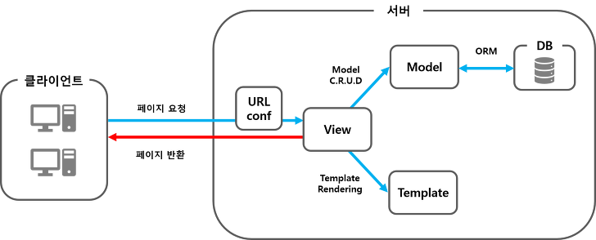
Features & Roles
Jisu An
Hyunjae Lee
Jinwoo Jeon
Server
Client
Request
Response
Notes:
진우

Slide 8
Features & Roles
Jisu An : Server setup, View functions
Server
Client
Request
Response
Notes:
진우

Slide 9
Features & Roles
Hyunjae Lee : DB modeling, View functions
Server
Client
Request
Response
Notes:
진우

Slide 10
Features & Roles
Jinwoo Jeon : Template, View functions, Session
Server
Client
Request
Response
Notes:
진우

Slide 11
Demo Scenario
Login with Google
Dashboard works
Upload files
Check them in DB
Notes:
현재

Slide 12
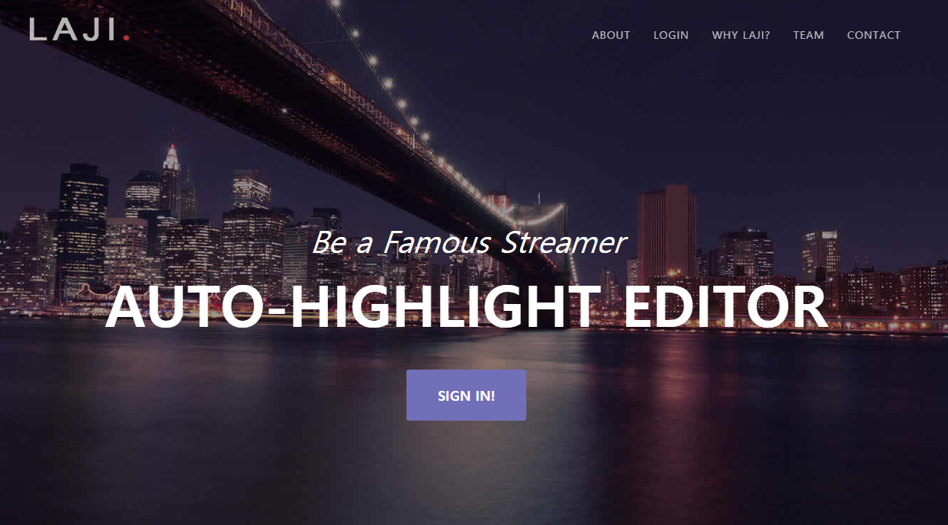
(1) Login with Google
/home
Google Login
Check if the user is in our DB
Register the user in our DB
No
Yes
Login
Redirect to /home
Notes:
현재

Slide 13
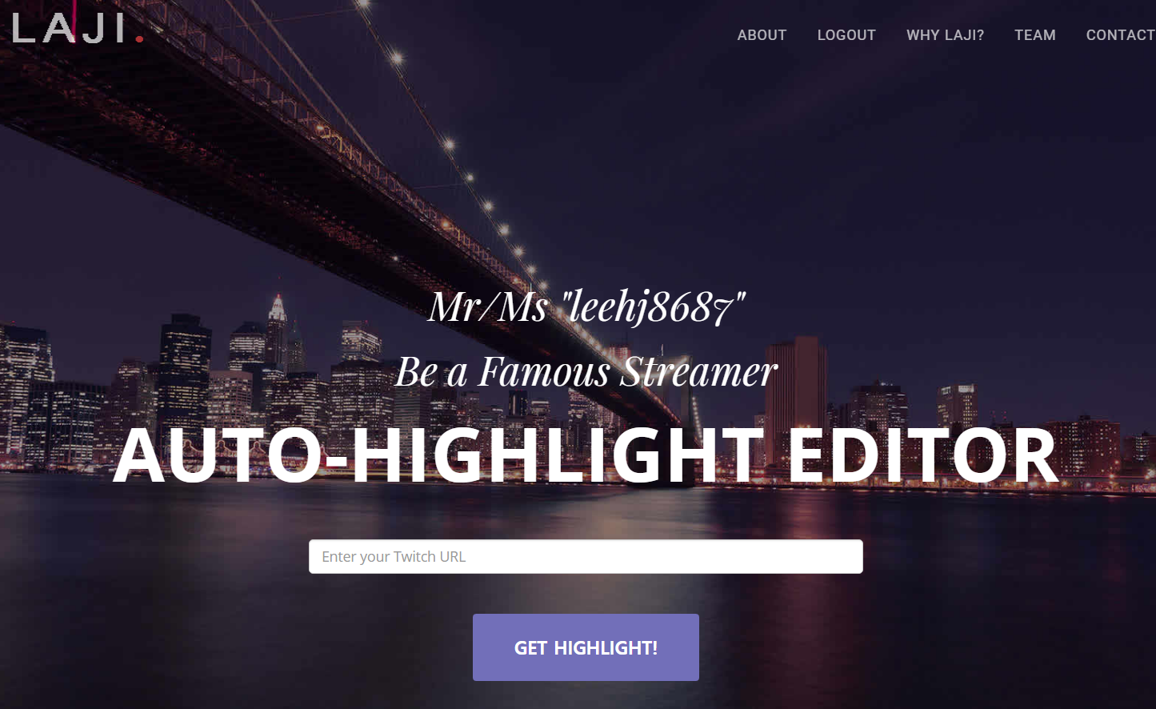
(1) Login with Google
/home
Google Login
Check if the user is in our DB
Register the user in our DB
No
Yes
Login
Redirect to /home
Notes:
현재

Slide 14
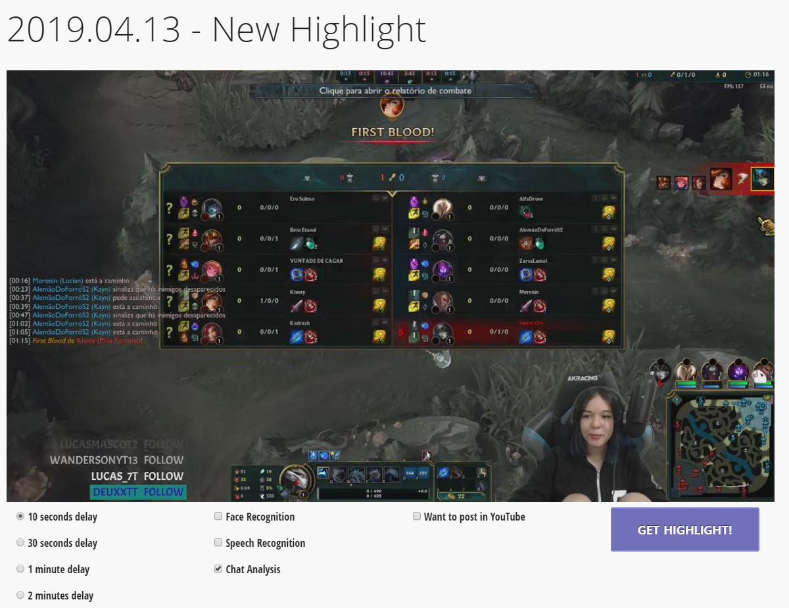
(2) Dashboard works
Notes:
현재

Slide 15
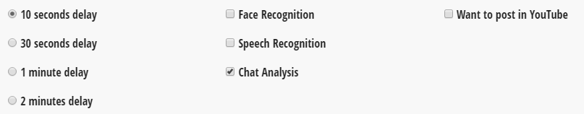
(2) Dashboard works
/mypage/dashboard
Option select
Store them in Session
Notes:
현재

Slide 16
(2) Dashboard works
/mypage/dashboard
Option select
Store them in Session
Notes:
현재

Slide 17
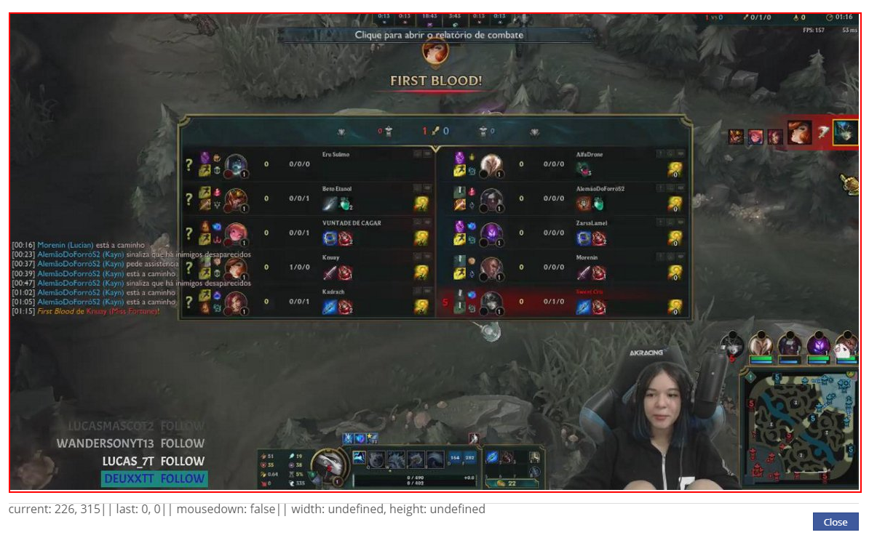
(2) Dashboard works
Popup Layer
Notes:
현재

Slide 18
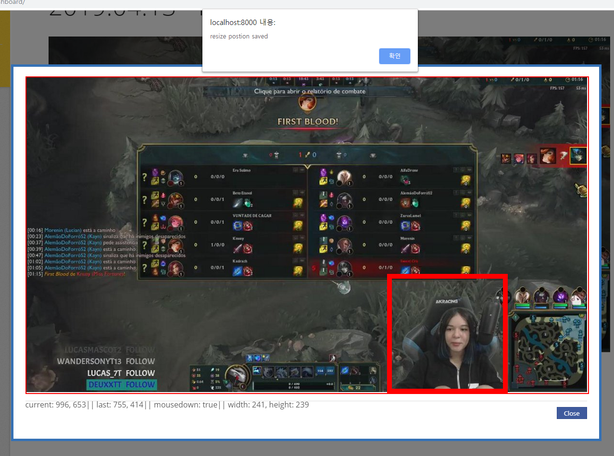
(2) Dashboard works
mousedown
mousemove
mouseup
Store in Session
Notes:
현재

Slide 19
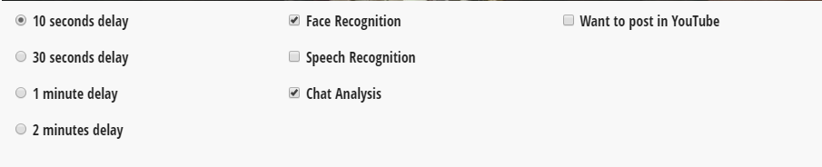
(2) Dashboard works
/mypage/dashboard
Option select
Store them in Session
Notes:
현재

Slide 20
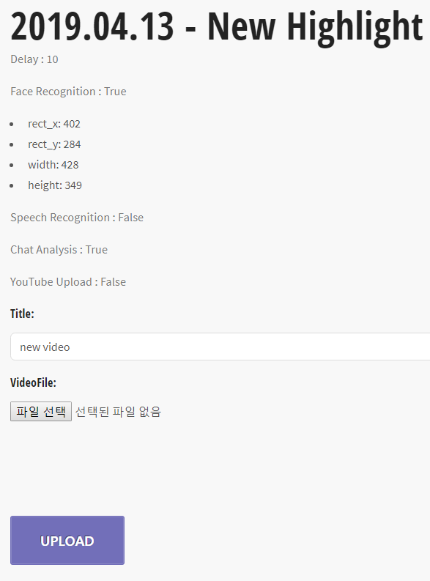
(3) Upload files
/mypage/upload
Option review
Upload
video file
Create Video obj
&
Store Video file in Server
Notes:
현재

Slide 21
(3) Upload files
/mypage/upload
Option review
Upload
video file
Create Video obj
&
Store Video file in Server
Notes:
현재

Slide 22
(3) Upload files
/mypage/upload
Option review
Upload
video file
Create Video obj
&
Store Video file in Server
Notes:
현재

Slide 23
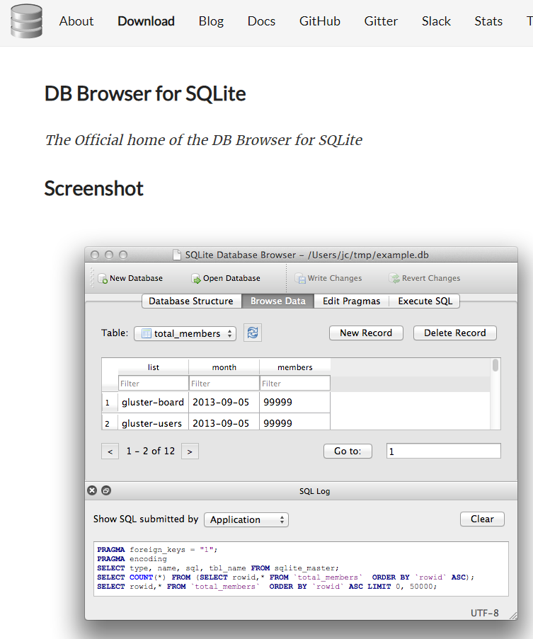
(4) Check them in DB
DB Browser for SQLite
Official
Check tables
Check table columns
Check records in the table
Notes:
현재

Slide 24
Demonstration
Notes:
지수

Slide 25
Development plans
Week | Plan
1st | Idea & Proposal
2nd | Idea & Proposal
3rd | Server construction (Configuration setup : Nginx, domain(bind9), https), Test videos (Twitch/Game/Eng)
4th | Login (SNS), Database
5th | Video upload & download, Twitch chat API analyze
6th | Frame resizing, Web UI, Designing highlight algorithm
7th | Demo
Notes:
지수

Slide 26
Development plans
What we are going to do
Black box
Process
Notes:
진우

Slide 27

Development plans
Original.mp4
(1) Crop Video (Ongoing)
Black box
Resized.mp4
Notes:
진우

Slide 28
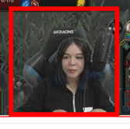
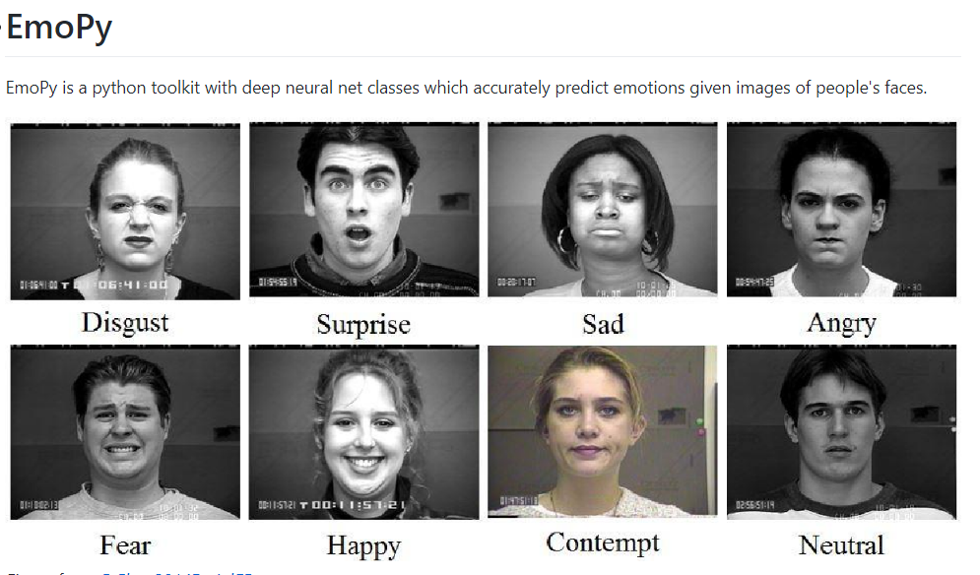
Development plans
Resized.mp4
(2) Face recognition
Black box
Emotion Vectors
Notes:
진우

Slide 29
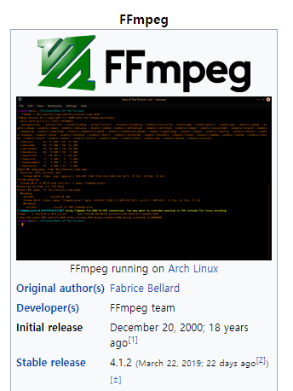
Development plans
Original.mp4
(3) Speech recognition
- Extract mp3 file
Black box
Original.mp3
Notes:
진우

Slide 30
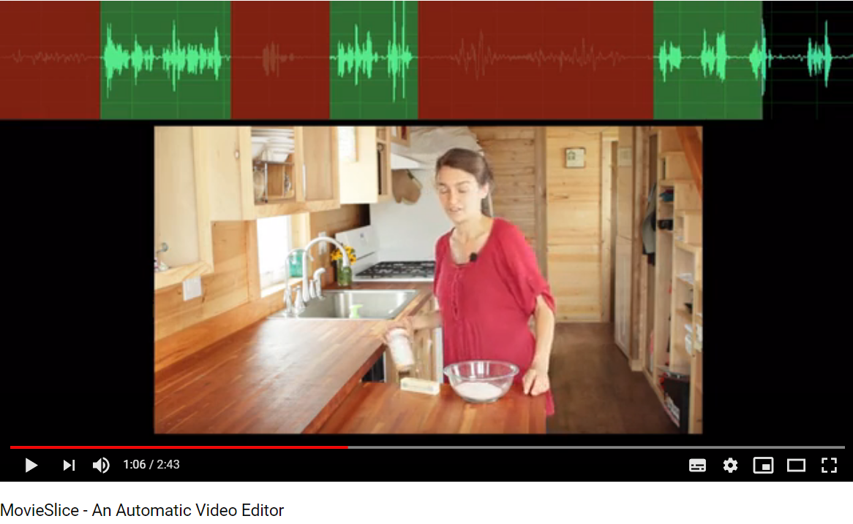
Development plans
Sliced.mp3
(3) Speech recognition
- MovieSlice
Black box
Smoothed.mp3
Notes:
진우

Slide 31
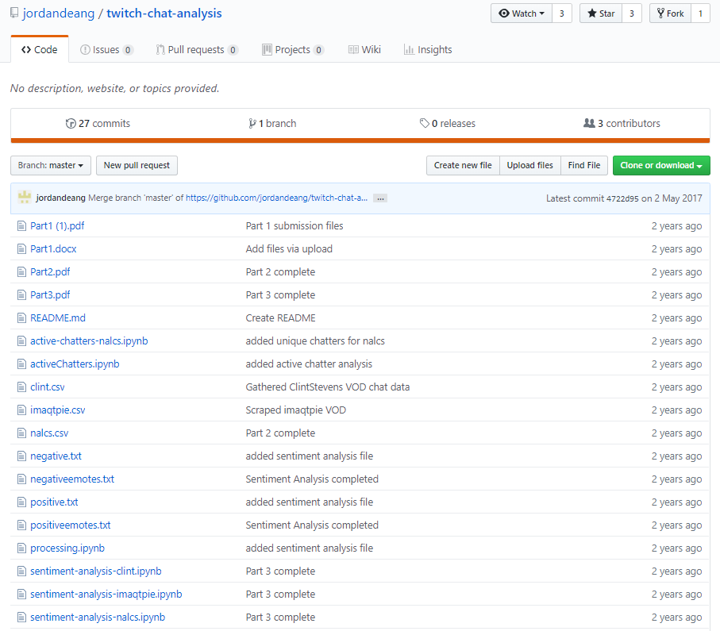
Development plans
Chatlog.txt
(4) Chat analyze
Black box
Emotion Vectors
Notes:
진우

Slide 32
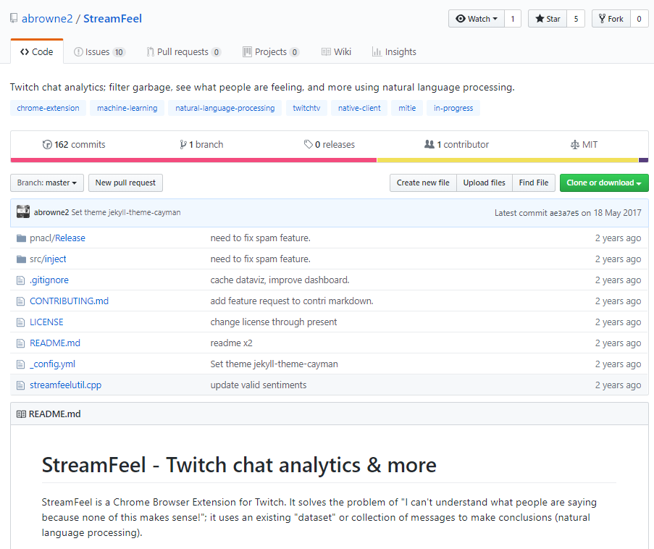
Development plans
Chatlog.txt
(4) Chat analyze
Black box
Emotion Vectors
Notes:
지수

Slide 33
Development plans
(5) Upload File Format
Only One Video Format
We can download video of our own in Twitch.
It’s .mp4
We assume that streamer will download it.
Only mp4 is allowed.
Notes:
지수

Slide 34
Development plans
8th | Highlight video analyze algorithm development, Linking database to system
9th | Highlight video analyze algorithm development, Linking database to system
10th | Highlight video analyze algorithm development and link to system, Linking database to system
11st | Toss (payment), Test
12nd | Notification mail, History, Server test
13rd | Preparing for Final demo
14th | Final demo
15th | Final report
Notes:
지수

Slide 35
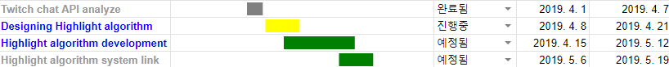
Development plans
Jisu An,
Hyunjae Lee,
Jinwoo Jeon,
Notes:
지수

Slide 36
Thank you!

